Slide 1

INFO 6105 – Data Science Engineering Methods & Tools
Final Project: Spotify Music Prediction Algorithm
Team Members:
1. Aditya Mulik
2. Tushar Kurhekar

Slide 2

Spotify Music Prediction Algorithm
Purpose of the Model?
To identify the popularity of a track using the track's attributes
This Photo by Unknown author is licensed under CC BY.

Slide 3
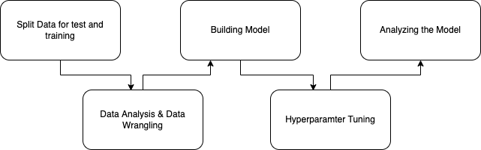
Machine Learning Journey

Slide 4
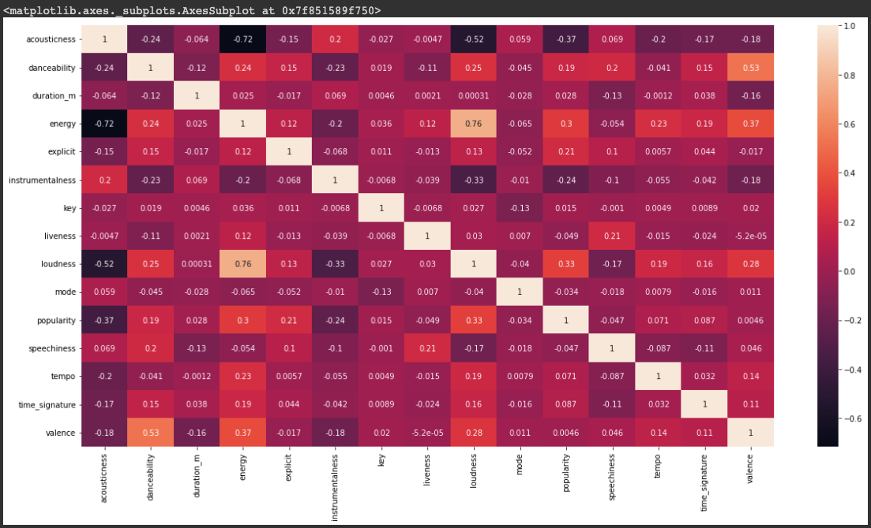
Data Analysis & Visualization
Some Observations from the HeatMap: The best features with the highest correlation which are used for feature engineering are acousticness, instrumentalness, loudness and energy

Slide 5
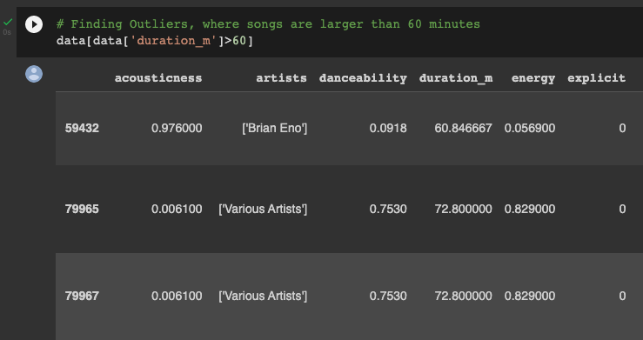
Data Analysis & Wrangling
We have sorted data by popularity of music
Converting the music duration to minutes
Identifying outliers such as music which are larger than an hour (Attached Screenshot)

Slide 6
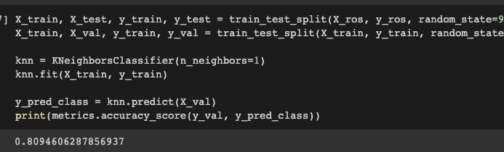
Splitting Data for attaining max accuracy
We have split data in test, train and validation dataset and build the model and received an 80% accuracy on the validation dataset.

Slide 7
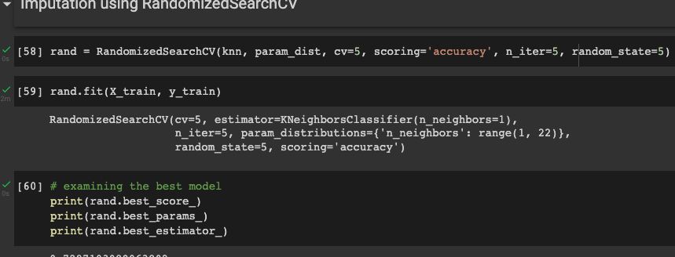
Model - Hyperparameter Tuning
We have tuned the model by hyperparameter tuning with the best possible solution for KNN Classification models
Here the tool used in RandomizedSearchCV

Slide 8

Conclusion
We trained our model, performed hyperparamter tuning and KNN classification model was the best fit for this type of data which received an accuracy score of approximately 76% which ensures no overfitting or underfitting of data.

Slide 9

Thank You

